Slide 1
Mail Apps for Office
Name
Title
Company

Slide 2
Agenda
Introduction to Mail Apps
Understanding Contextual Activation and Rules
Using JSOM for Outlook
Security Considerations
Design Guidelines

Slide 3
Introduction to Mail Apps

Slide 4
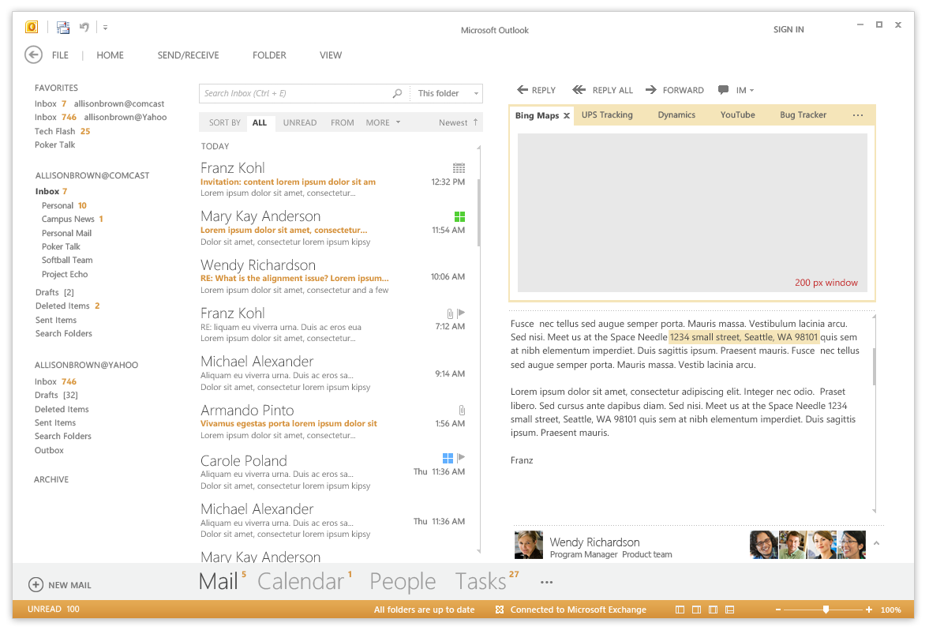
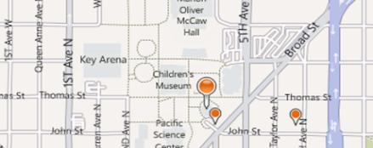
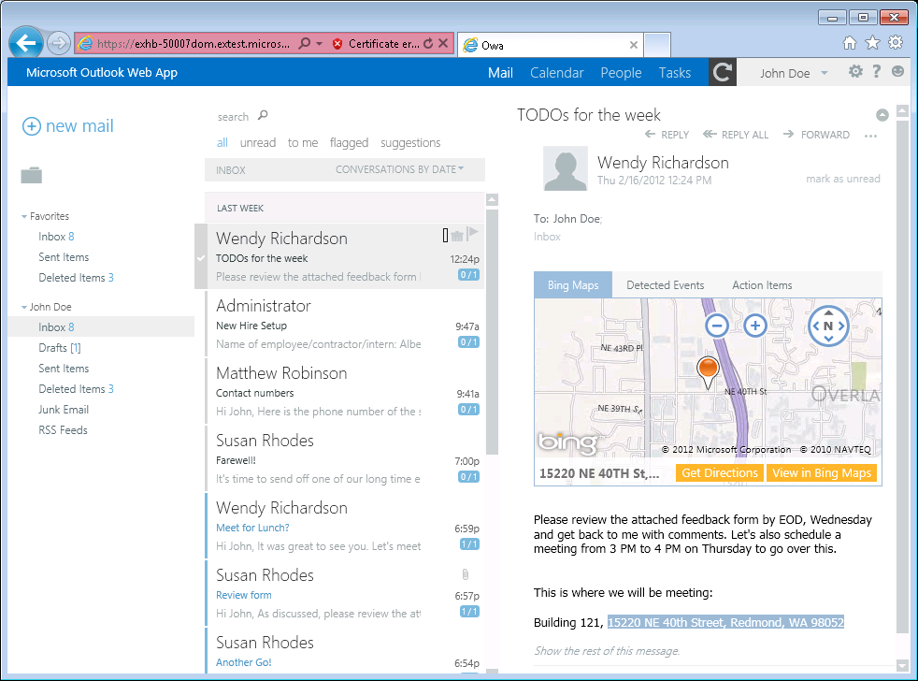
Mail Apps
Write once, run anywhere Outlook runs
Same Mail App runs on Outlook and OWA
Development model based on activation rules
Activation rules run whenever user selects item
Activated mail apps are added into Outlook UI
Designed to be secure
Mail apps run in an isolated, sandboxed process
Mails apps run with a three-tier permission model
Notes:
A key concept of mail apps is that they are written once and can run anywhere Outlook runs including the rich client, the browser and mobile devices. The development model for mail apps based on activation rules. The idea is that activation rules for all installed mail apps run whenever user selects item. All mail apps whose activation rules result in activation are then available to use within the context of that selected item. Furthermore, the experience of app activation and starting a mail app is consistent across Outlook and OWA. When a mail app is started by the user, the mail app is designed to provide the user with contextual information for the selected e-mail message, meeting request, or appointment.
The infrastructure for mail apps has been designed to be secure. With Outlook, mail apps are run in an isolated, sandboxed process. In the browser, mail apps are isolated within their own iFrame. As you will see later in this model, mails apps run with a three-tier permission model which affords a great deal of power in a secure manner.

Slide 5

Mail Apps – Up Close and Personal
App Name
Mail App Body
Context trigger
Notes:
This slide shows some key aspects of how mail apps integrate into the Outlook and OWA user interface.
When a mail app has activated for a specific Outlook item, its App Name appears in a special App Bar just above the body of the host mail item. A user can start up a mail app by clicking on the App Name in the App Bar. This action results in the mail app loading which will display the Mail App Body. Many activation rules for mail apps are based on finding specific types of content in the host item. For example, the Bing Maps mail app looks for content inside the body that is interested as an address. Such content is considered a Context Trigger and is highlight in the body of the mail item showing the user what specific data the mail app is using to do its work.

Slide 6






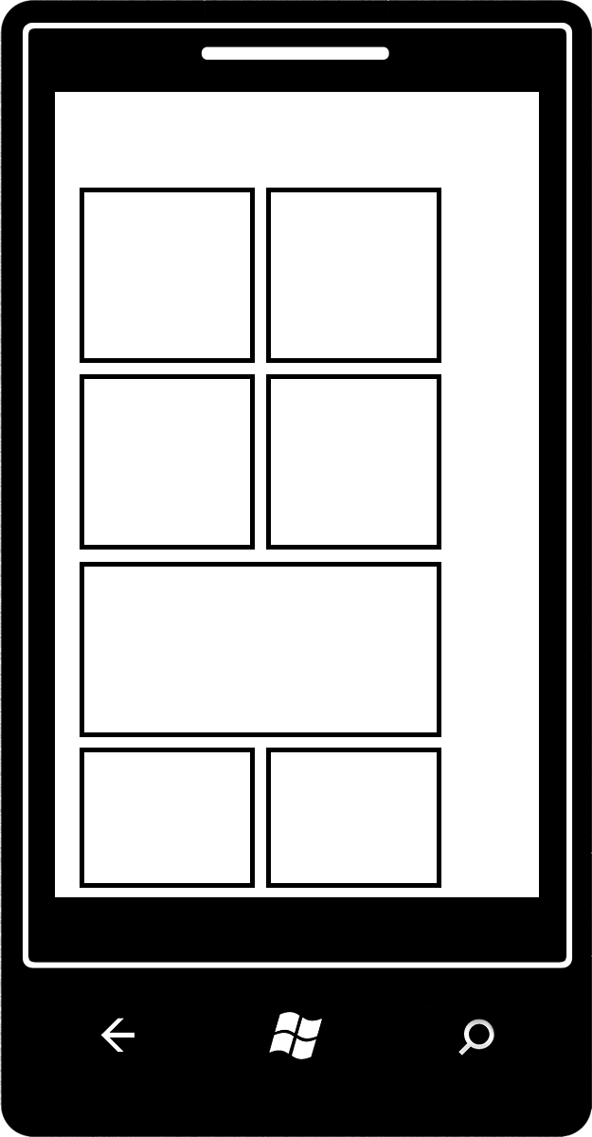

Mail App Hosting
Mail Apps require Exchange 2013
Exchange Server hosts users mailbox
Exchange Server hosts app manifest files
Web server hosts HTML for Mail App
Mail App can make callback to Web server
Mail App can call Exchange Web Services (EWS) EWS calls can be brokered through Web server
Exchange Server
Hosts mailboxes for users
Host Mail App Manifests
EWS
Web Server
Hosts HTML, CSS and JavaScript
Supports CSOM/REST calls from app
Notes:
The infrastructure for mails apps require Exchange 2013 and an Exchange Server which hosts users mailboxes. When a mail app is installed, its manifest must be uploaded into the Exchange App Catalog. However, the implementation for a mail app which includes HTML, CSS and JavaScript is not deployed with Exchange but instead on any standard Web server that can serve up HTML pages.
One powerful aspect of developing mail apps is that they can call Exchange Web Services (EWS) which provides the ability to create new email message and appointments and to read other mail items in the current users inbox. Calls to EWS can be made directly from JavaScript behind the mail app itself. However, the mail app can also call back to its hosting Web server passing the required security credentials so that the Web server can call into EWS. This makes it possible to work with server-side code behind a mail app that does its work in C# and VBNET and still has the power to call into EWS.

Slide 7
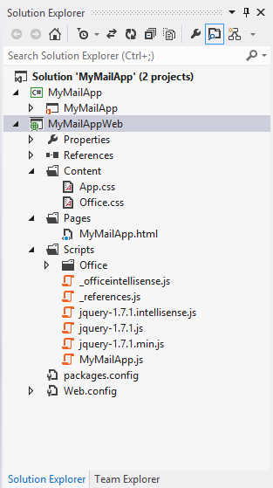
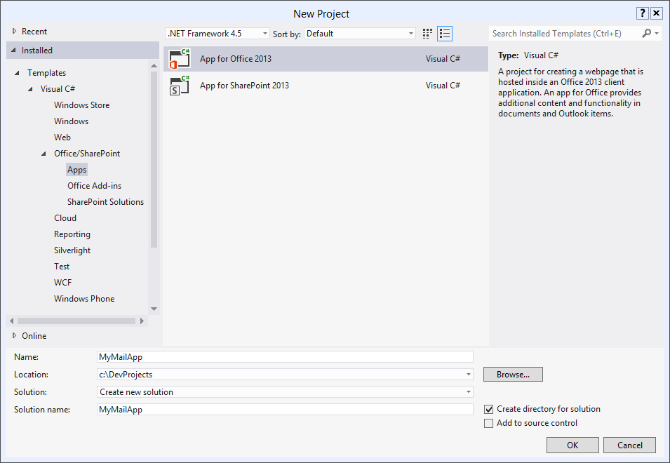
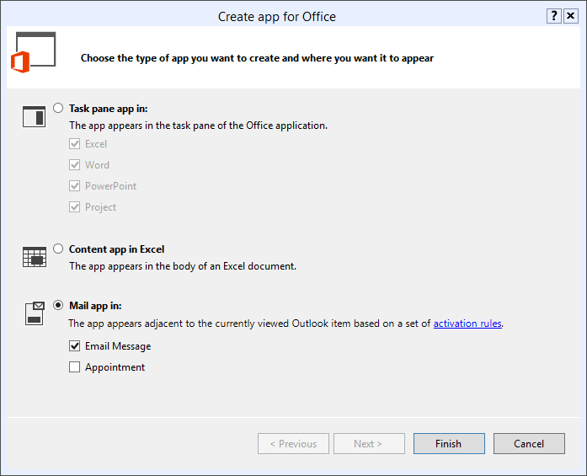
Developing Mail Apps
Use the Visual Studio project template for Mail Apps
Notes:
To create mail app, you can use Visual Studio 2012 and a new project template dedicated to creating mail apps.

Slide 8
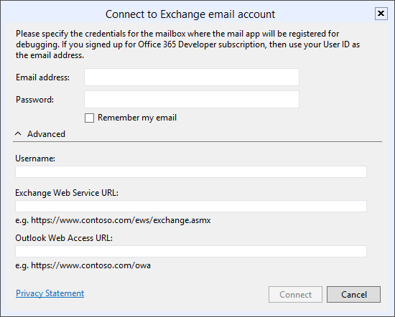
Steps to Implementing, Testing and Debugging
Specify height from 32 to 350 pixels
Define activation rules
Create UI and style with CSS
Write JavaScript to add behavior and business logic
Debug using Exchange Server and a valid Exchange account
Press {F5} and Visual Studio prompts for server and user mailbox credentials
Notes:
This slide details the high-level steps of creating a mail app. Within the app manifest, you should specify a height for the mail app between 32 pixels to 350 pixels. Note that you cannot specify the width as the mail app will take up all the available width in the host application. Next, you define one or more activation rules. Next, you create the user interface for the mail app using HTML5 and CSS. After that, you write JavaScript to add the required behavior and business logic. When you are finally ready to test your work, you can press the {F5} key to begin the debugging process.
In order to test and debug a mail app, you must have a installed version of Exchange 2013 and a valid Exchange account with a mailbox. When you press the {F5} key for the first time Visual Studio 2012 prompts you with the dialog shown above to track the server running Exchange 2013 as well as the login credentials for the user mailbox used for testing.

Slide 9
Working with Mail Apps for Outlook
demo

Slide 10
Understanding Contextual Activation

Slide 11
Rule-based Activation
Mail Apps activate based on rules
Rules are defined in the manifest
Rules are applied to the selected item in the Explorer or Inspector
If conditions are met, the App will be activated and available for use
About rules
Multiple rules can be combined for complex activation needs
Apply logical AND or OR operators
Rules can access known entities such as phone numbers
Rules can be defined using regular expressions
Notes:
Every mail app is created with one or more activation rules. These rules are defined in the app manifest using XML. These activation rules are run for each installed mail app whenever the user select a new mail item that is a mail message, and event or an appointment. If the conditions for an activation rule are met, then the mail app is activated and becomes available to start by the user.
A simple mail app can be based on a single activation rule. However, a mail app can contain multiple rules that can be combined for complex activation needs. When you add more than one activation rule, you must decide whether to AND the rules together or to OR the rules together.
Activation rules can be based on known entities such as address and phone numbers. For more specific scenarios, activation rules can also be defined using custom regular expressions.

Slide 12
Activation Rule Types
ItemIs
A rule that checks the item type (appointment or message)
<Rule xsi:type=“ItemIs” ItemType=“Message”>
ItemHasKnownEntity
A rule to check if the item has a specific type of known entity
<Rule xsi:type=“ItemHasKnownEntity” EntityType=“Address” />
ItemHasRegularExpressionMatch
Defines a rule using a custom regular expression to match the contents of an item
RuleCollection
Defines a rule composed of multiple rules (combined using AND or OR)
Notes:
There are several different types of activation rules.
The ItemIs rule checks to see whether the item type is a message or an appointment.
<Rule xsi:type=“ItemIs” ItemType=“Message”>
The ItemHasKnownEntity rule checks to see if the item has a specific type of known entity
<Rule xsi:type=“ItemHasKnownEntity” EntityType=“Address” />
The ItemHasRegularExpressionMatch rule checks to see if an item has content that matches custom regular expression.
The RuleCollection rule combines two or more inner rules using either the AND operator or the OR operator. When using the AND operator, all inner rules must be met for activation to occur. When using the OR operator, only one inner rule must be met for activation to occur.

Slide 13
Well-known Entity Examples
Outlook is aware of specific types of entities
Items are parsed and scanned for common types of entities
Use ItemHasKnownEntity rules to based activation rules on entities
Within app use API functions getEntities or getEntitiesByType
Entity type | Recognition condition
Address | United States street addresses 1 Microsoft Way, Redmond, WA 07722
EmailAddress | Any SMTP email address
MeetingSuggestion | A reference to an event or meeting Let’s meet next Tuesday for lunch.
Contact | A personal name related to other entities Steve Ballmer, Microsoft, 1 Microsoft Way, Redmond, WA 07722
PhoneNumber | United States telephone numbers (507) 555-1212
TaskSuggestion | Actionable sentences in an email Please install Office 2013 on my computer.
Url | A file name or web address
Notes:
Outlook 2013 is aware of several specific well-known types of entities which are listed in the table on the slide above. When you create an activation rule based on one of these entities, Outlook will parse and scan the current item for the presence of content that matches that type of entity.
To create an activation rule based on a well-known entity with XML inside the app manifest, you use the ItemHasKnownEntity rule
<Rule xsi:type=“ItemHasKnownEntity” EntityType=“Address” />
When you are writing JavaScript code for the mail app, you will need to retrieve the entity value which can be done using the API functions getEntities or getEntitiesByType.

Slide 14
Creating Rules that Trigger Activation
demo

Slide 15
Using JSOM for Outlook

Slide 16
Accessing the Outlook JSOM
Outlook App OM available application object
Office
context
mailbox
item
userProfile
document
Notes:
The Office javascript model provides a consistent API across products through the document object, allowing you to interact with the document. A specific API is implemented through the context object, providing APIs that are specific to working in the context of Outlook. Access to the Outlook JavaScript Object Model (JSOM) is available through the Office.context.mailbox object. From here you can obtain access to information about the selected mail item and user profiles for the current user as well as other users such as the one that sent the message.

Slide 17
The Outlook App OM for Mail Apps
Access to item properties
Recipients of the current message
Subject, date sent and other item properties
Meetings (start, end, attendees and location)
User profile info
Name, email address, time zone
Regex matches and known entities
Use for activation rules and within App
Limited Exchange Web Services (EWS) access
Look up items in mailbox
Create appointments, messages, tasks and contacts
Send messages/meeting invites
Token for Single Sign-on
Office.context.mailbox
Display forms
User token and SSO
User Profile
Items
Calls to EWS
Notes:
The Outlook JSOM provides access to item properties such as the sender and the recipients of the current message. There are also properties providing access the item information such the subject and the date sent.
For meeting and appointment items, you can access the date and time of the stat and end as well as all attendees and meeting location.
User profile information available includes the name, email address and time zone.
You can access matches to well-known entities and regular expression matches.
If your mail app has requested the appropriate level of permissions, the code in your mail app also has limited access to Exchange Web Services (EWS). This makes it possible to enumerate through and look up other items in the current user's mailbox. You can also create appointments, messages, tasks and contacts as well as create and send messages and meeting invites.
The JSOM also provides a means to create a single sign-on token that is used to call into EWS.

Slide 18
Outlook APIs – some examples
Accessing item properties:
Accessing user profile info:
Access to regex matches:
Access to extracted entities:
Notes:
The slide above shows some code examples to get you started with the JSOM.
The item provides access to item properties such as subject.
The userProfile property provides access to properties such as displayName.
The getRegExMatches method provides access to content found which matches a regular expression that has been included in an activation rule.
The getEntities method provides access to content found which matches a well-known entity that has been included in an activation rule

Slide 19
Advanced Outlook App OM Functions
Office.context.mailbox
displayAppointmentForm – Displays existing appointment
displayMessageForm – Displays existing email message
displayNewAppointmentForm – Displays new appointment form
getUserIdentityTokenAsync – Gets identity token of the user
makeEwsRequestAsync – Call Exchange Web Services service
Office.context.mailbox.item
displayReplyForm – Displays form for replying to the sender
displayReplyAllForm – Displays form for replying to all recipients
Notes:
The OutlookAppOM object provide several useful methods for more advanced scenarios.
The displayAppointmentForm method is used to display a standard form showing information for existing appointment
The displayMessageForm method is used to display an existing email message
The displayNewAppointmentForm method is used to display a new appointment form for cases where the user needs to fill in information to create a new appointment.
The getUserIdentityTokenAsync is used to retrieve a security token which can be used to make multiple calls back to EWS under the identity of the current user.
The makeEwsRequestAsync method is used to call a function exposed by EWS.

Slide 20
Using Custom Properties
Custom properties are associated with an item
Similar to settings for a document-centric Apps for Office
Difference is data is associated with item instead of document
When items re-opened, app can load/process/display property
Using custom properties
Item object has loadCustomPropertiesAsync method
CustomProperties object has methods for get, set, remove and saveAsync
Notes:
The JSOM object model makes it possible to save one or more custom properties for a mail item and to later retrieve them to implement custom business logic. Remember that each custom property value is associated with exactly one item. Programming custom properties in a mail app is similar to the way it works in a document-based app. The main difference is that property values are associated with items instead of documents. When an mail app is started within a scope of an item, you can write code to load the custom properties to retrieve custom property values that have been save at an earlier time.
When you need to actually write the code to work with custom properties, you will use the loadCustomPropertiesAsync method available on the item object. Once you create a custom property, you must save your work by calling the saveAsync method.

Slide 21
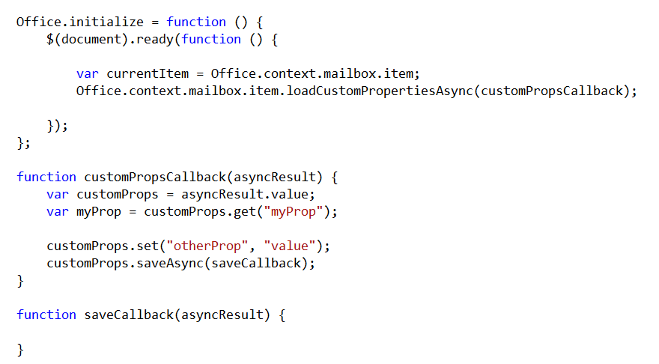
Outlook APIs for Custom Properties
Custom Properties are per-app, per-item property bag
Saved on the Exchange server
Uses async programming pattern
Notes:
Custom properties are stored in Exchange server on a per-app basis which implies that two different mail apps can read and write a common set of custom properties. The code in the slide above shows a simple example demonstrating how to read and write custom properties. You start by calling loadCustomPropertiesAsync and passing a callback method. This callback method is passed a asyncResult object with a value property which contains the collection of existing custom properties. You can read an existing property value by calling the get method and passing the property name. The get method returns an undefined value if the named property does not already exist.
You can use the save method to create a new property or to update the value of an existing property. Note that the save method has no real effect unless you follow it with a call to saveAsync to save the new property value back to the Exchange server.

Slide 22
Programming with the Outlook App Object Model
demo

Slide 23
Security Considerations

Slide 24
The Four Stakeholders of Security and Privacy
Office Marketplace hosted by Microsoft
Ensure integrity of marketplace
Perception of Microsoft products
App Developers
Needs to be aware of security-related constraint
Ability versus constraint
End Users
Privacy of personal information
Protect computers from attack
IT Department & Exchange Administrator
Privacy and protection of corporate information
Protect computers from attack
Notes:
There are four main stakeholders in the security story for mail apps.
The Office.com team at Microsoft hosts The Office Marketplace and has the incentive to ensure the integrity of all mail apps available in the Marketplace.
Mail app developers need to be aware of security-related constraints. It is essential to understand the trade off between requesting higher levels of permission to provide the mail app with greater ability and working under constraints enforced by lower permission levels as to not require higher levels of trust from users and administrators. The bottom line is that your mail app should request the minimum of permissions that are required.
End users are concerned with the privacy of their personal information and with the ability to protect their computers and mobile devices from attack
The IT Departments and Exchange Administrators are concerned with the privacy and protection of corporate information and intellectual properties. They are also concerned with protecting all computers including servers from attack.

Slide 25
Permissions and Capabilities
Read/write mailbox permission
Restricted
Use only extracted item entities but no custom regular expressions
Partial OM access and no access makeEWSRequestAsync
ReadItem
Use custom regular expressions
Full JSOM access except no access to makeEWSRequestAsync
Read & write properties for current item
ReadWriteMailbox
Use Exchange Web Services (EWS) operations
Create, read, write items & folders
Send items
Read item permission
Restricted permission
Low trust: end-user can install for self
High trust: Exchange administrator must install
Notes:
Each mail app is defined with a RequestedCapabilities setting in its manifest which determined the level of permission and the level of trust it requires from users and administrators.
A setting of Restricted requires the lowest level of trust. A mail app with this setting can read well-known item entities extracted from an item but the mail app cannot read the item body nor can it use a custom regular expressions. The mail app has partial access to the JSOM but no access to EWS.
A setting of ReadItem requires a medium level of trust. A mail app with this setting can do anything possible with a restricted setting but it adds other permissions such as the ability to use custom regular expressions and provides full access to the JSOM with the exception of making calls to EWS.
A setting of ReadWriteMailbox requires the maximum level of trust and prevents the mail app from being installed directly by users. This type of mail app can only be installed by the exchange administrator because it adds the ability to call EWS which makes it possible for the mail app to create, read, write and send mail items and to create folders to manage items in a more structured fashion.

Slide 26
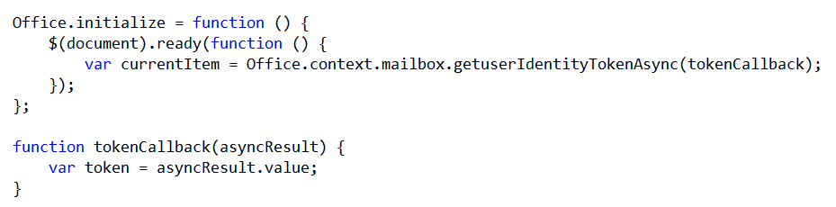
Single Sign On API
Outlook App OM allow you to retrieve token for current user that contains:
User Principal Name (UPN)
The user’s SMTP address
A unique identifier
Mail Apps should use the following flow for single sign-on:
Get user token using a call to Office.context.mailbox.getUserIdentityTokenAsync()
On first use, have the user log in to the partner’s service
Pass the token along with the log in credentials
Validate the token server-side and create a mapping (unique ID > user credentials/identity)
On subsequent uses, look up the user via the mapping and perform authorization
Notes:
The JSOM allows mail apps run with ReadWriteMailbox capabilities to call to EWS. In order to do this you must retrieve a security token for current user that contains information such as the User Principal Name (UPN), the user’s SMTP address and a unique identities that Exchange tracks on the server-side to map a security token to a specific user identity.
Mail Apps should use the following flow for programming a EWS session with single sign-on:
Get a security token for the current user by calling outlookAppOm.getUserIdentityTokenAsync.
On first use, have the user log into the service for the mail app which involves passing the log in Credentials to an Exchange 2013 mailbox.
Pass the security token to the mail app service.
Inside server-side code behind the mail app, validate the security token and create a mapping of the unique ID to a user identity.
Call into EWS from the mail app service passing the security token with each call.

Slide 27
Design Guidelines

Slide 28
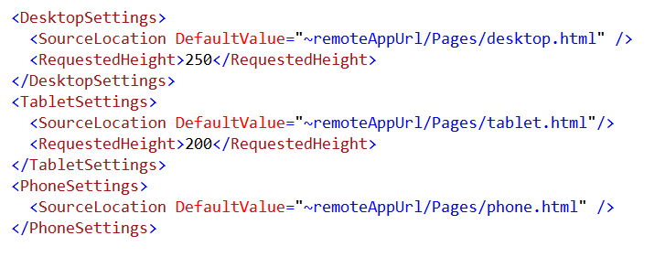
Guidelines for Designing Mail Apps
Layout Guidance
Give mail app height between 32 and 350 pixels
No control over width – design appropriately
Scrollbars should be avoided in Mail apps
You can explicitly hide scrollbars with CSS <body style=“overflow:hidden”>
Leverage Support for Other Form Factors
Provides easy way to deal with UI constraints for phones or tablets
Notes:
Microsoft provides layout guidance for mail apps. Inside the mail app manifest you should specify a height between 32 pixels and 350 pixels. You should understand that you have no control over width. Therefore you must design and test your work appropriately. Scrollbars should always be avoided in mail apps. You can explicitly hide scrollbars in the HTML body element for a mail using a CSS rule which sets the overflow property to a value of hidden.
Mail apps provide convenient assistance to deal with three different form factors including the DesktopSettings, TabletSettings and PhoneSettings. This provides easy way to deal with the more limited UI constraints for phones or tablets because you can supply a completely different start page with its own unique HTML and CSS rules for each of the three form factors.

Slide 29
Other Mail App Design Considerations
Request appropriate capabilities
Request using the RequestedCapabilities element in the manifest
Apps requesting ReadWriteMailbox can only be installed by admins
ReadItem is needed to write custom properties
Restricted has limited JSOM access and cannot use custom RegEx
Be mindful of App performance
Outlook desktop client enforces resource usage limits
Thresholds may be adjusted by administrators
Regex evaluation, CPU usage, memory usage and stability
Notes:
When designing a mail app, you should consider what level of permissions it needs in order to correctly set the RequestedCapabilities value on the mail app manifest. The following list details some specific issues.
Restricted has limited JSOM access, no access to the item itself and cannot use custom regular expressions.
ReadItem is needed to write custom properties or read the item.
ReadWriteMailbox requires installation by an exchange admins.
When creating a mail app, you should be concerned with it performance. Note that the Outlook desktop client enforces resource usage limits and it will automatically disable mail apps that it finds to perform poorly. The thresholds for performance can be adjusted by administrators. The metrics look at performance characteristics such as the processing of Regex evaluation, CPU usage, memory usage and stability.

Slide 30
Summary
Introduction to Mail Apps
Understanding Contextual Activation and Rules
Using JSOM for Outlook
Security Considerations
Design Guidelines

Slide 31
Q&A

Slide 32

© 2012 Microsoft Corporation. All rights reserved. Microsoft, Windows, Windows Vista and other product names are or may be registered trademarks and/or trademarks in the U.S. and/or other countries.
The information herein is for informational purposes only and represents the current view of Microsoft Corporation as of the date of this presentation. Because Microsoft must respond to changing market conditions, it should not be interpreted to be a commitment on the part of Microsoft, and Microsoft cannot guarantee the accuracy of any information provided after the date of this presentation. MICROSOFT MAKES NO WARRANTIES, EXPRESS, IMPLIED OR STATUTORY, AS TO THE INFORMATION IN THIS PRESENTATION.

